Slide 1
Academy Transportation
& Concept
Special Board Meeting
November 8, 2017

Slide 2



Current academies
Math, Engineering & Science Academy (MESA)
Albemarle High School
Opened: 2009
Current Enrollment: 261
Health and Medical Sciences Academy (HMSA)
Monticello High School
Opened: 2012
Current Enrollment: 163
Environmental Studies Academy (ESA)
Western Albemarle High School
Opened: 2014
Current Enrollment: 132

Slide 3
Academy Enrollment

Slide 4
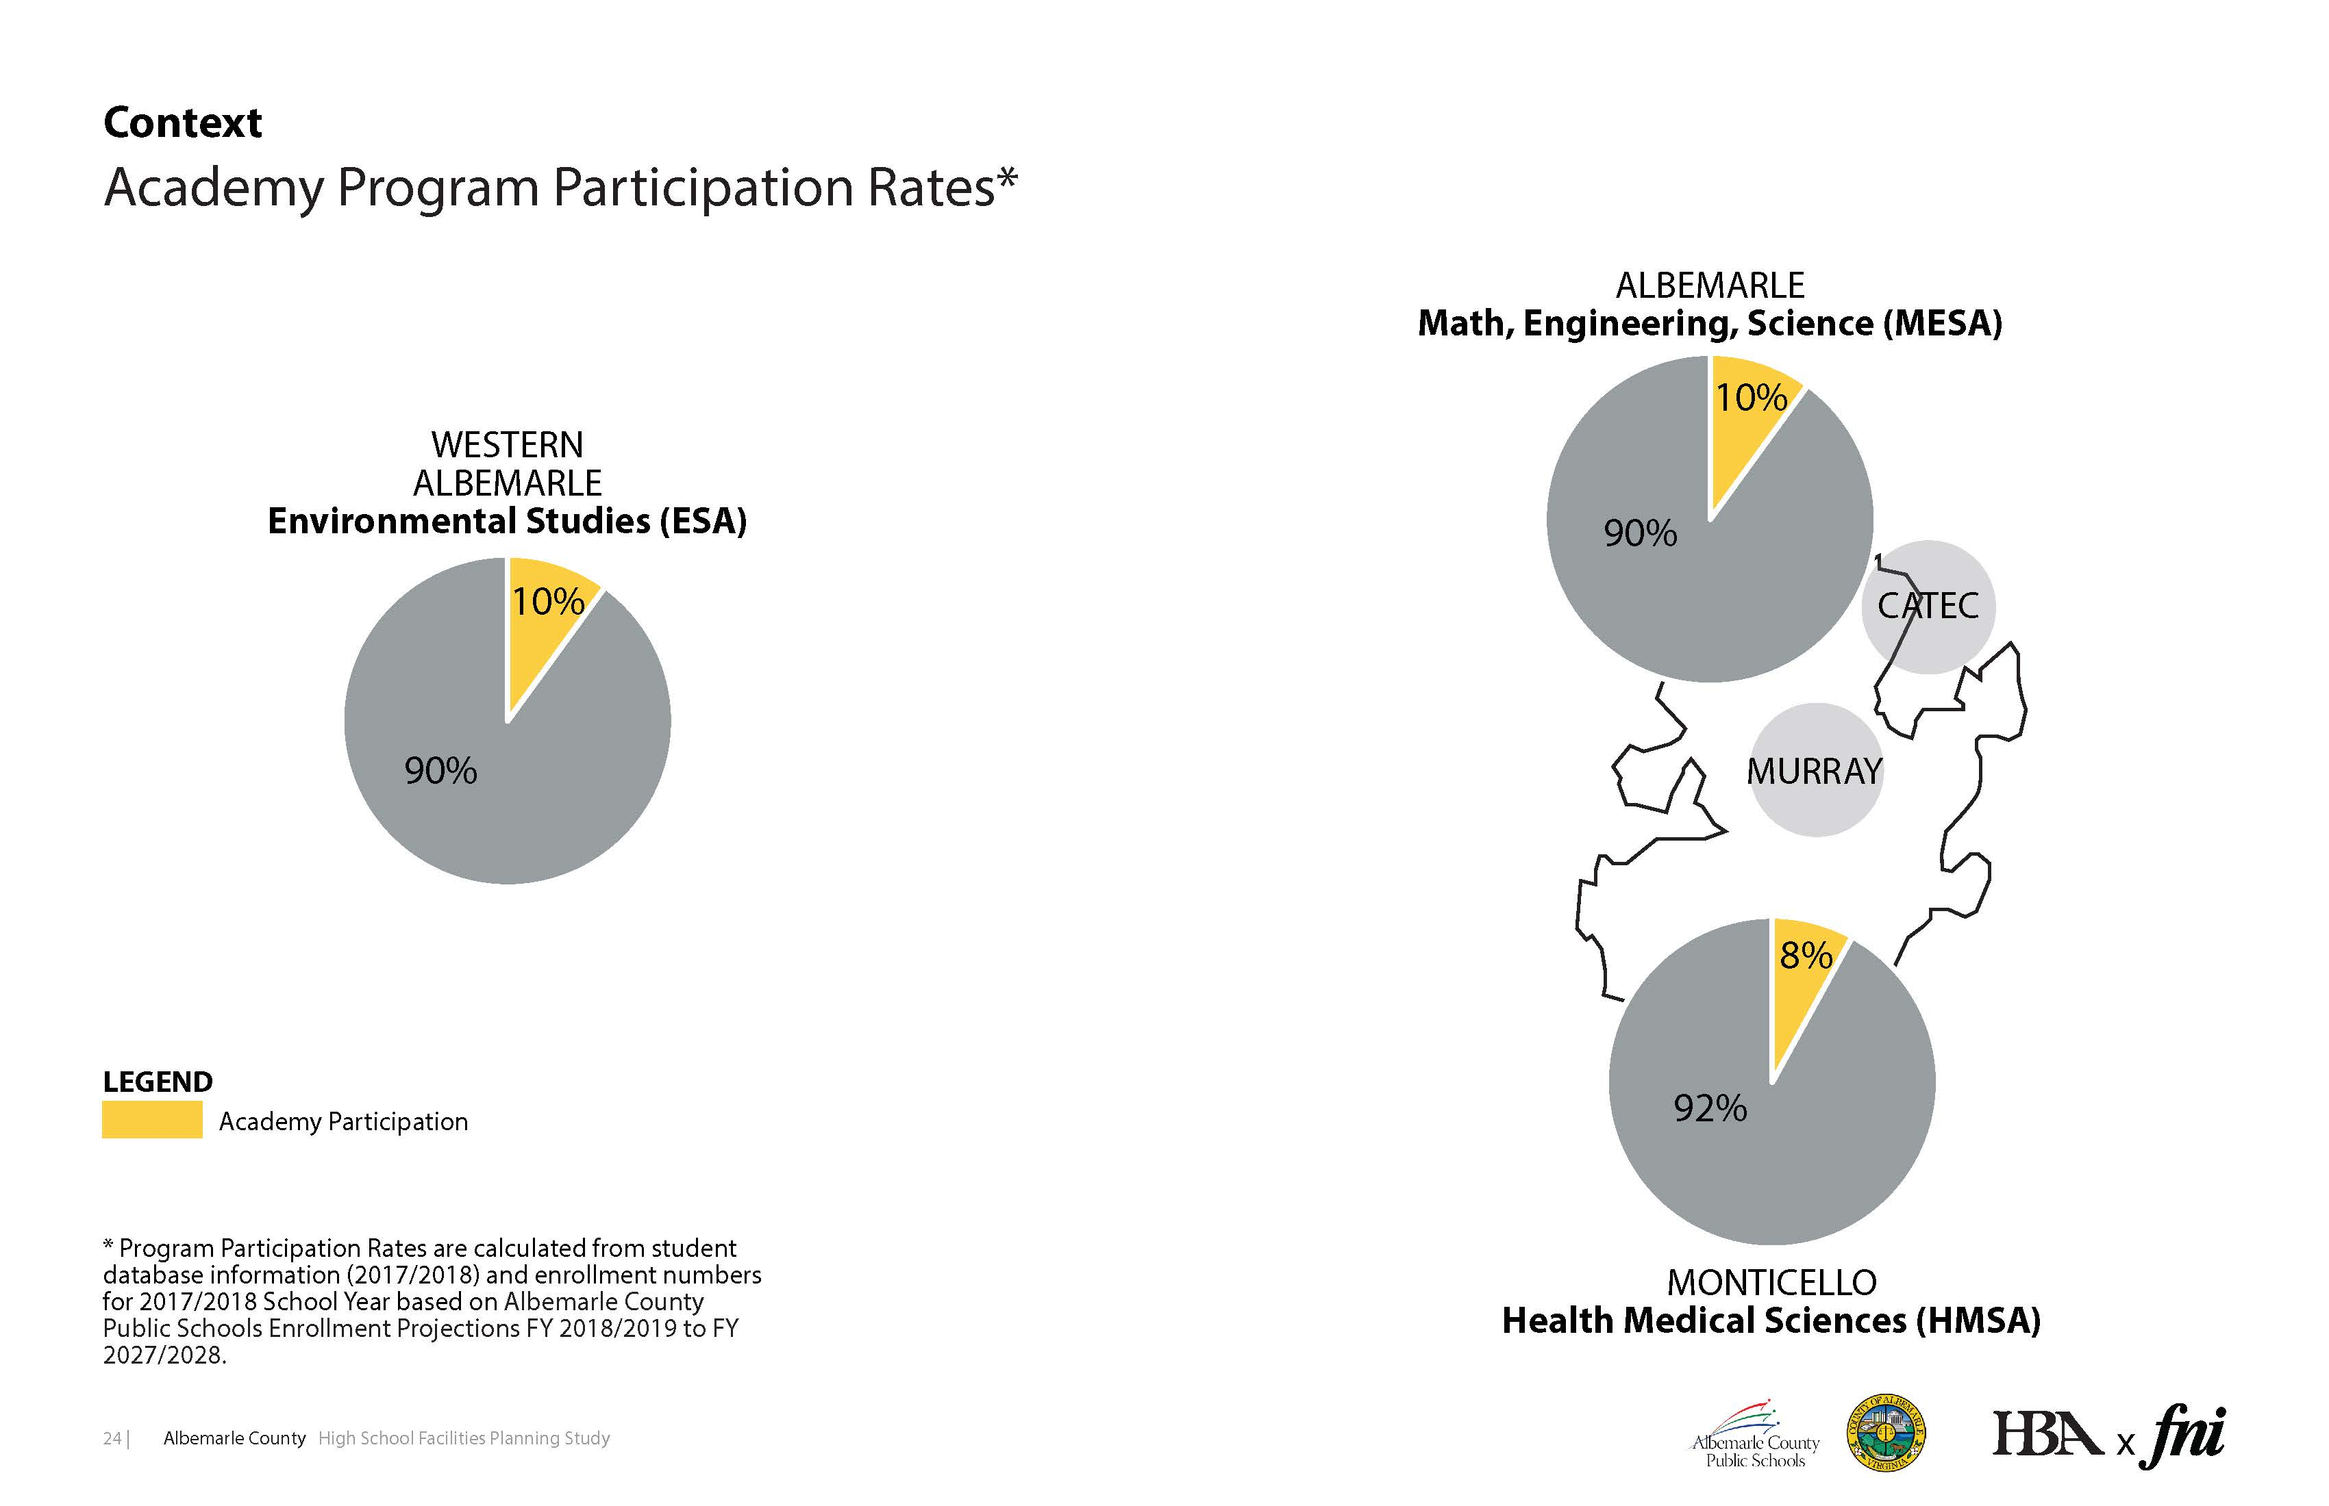

Slide 5
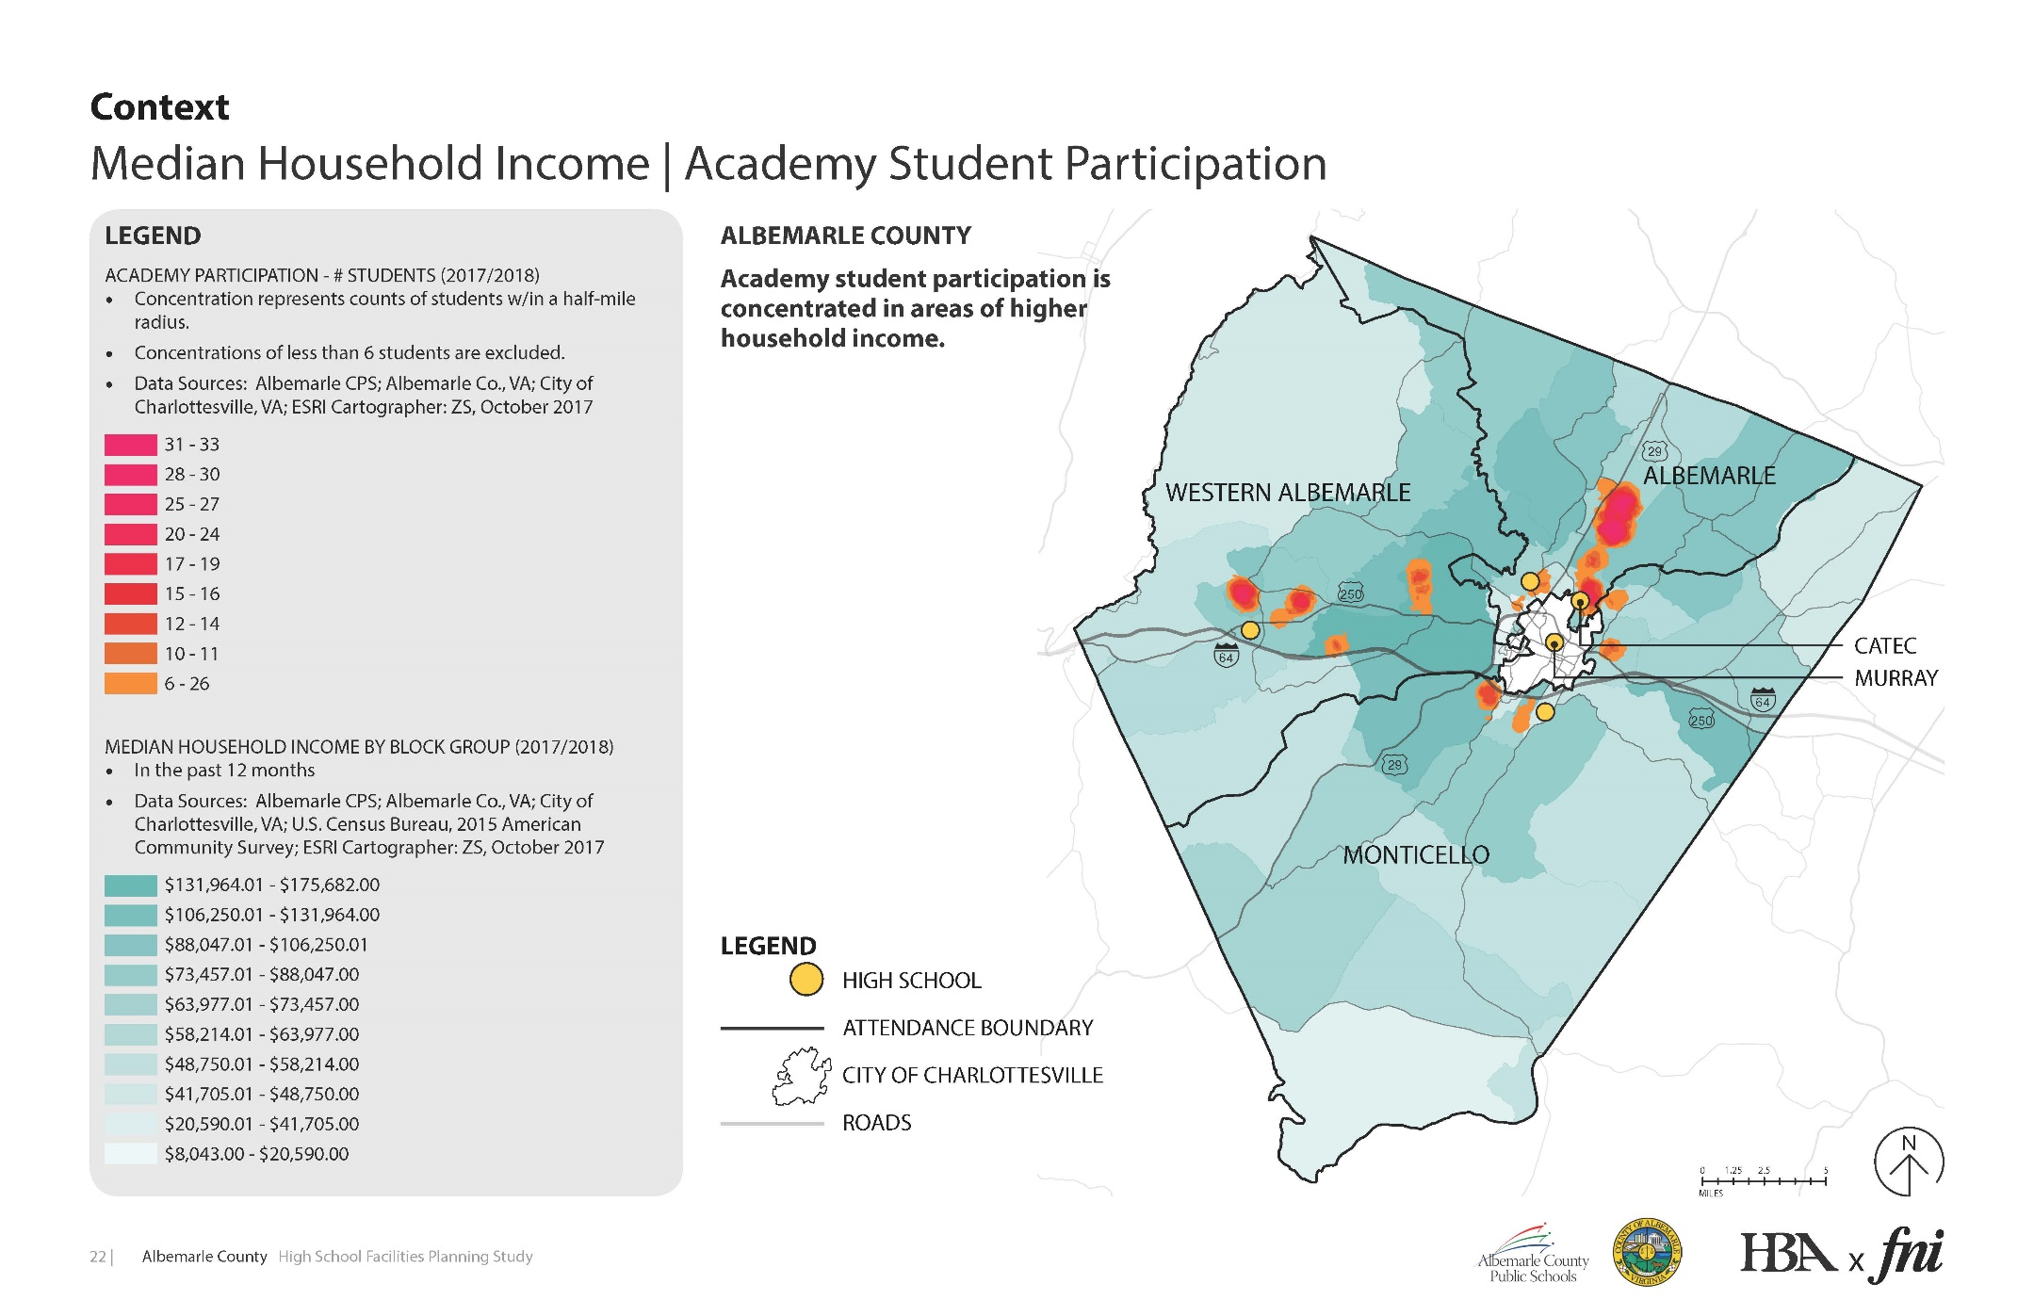

Slide 6
Academy enrollment by district
Academy | Total Enrollment | Albemarle District | Western District | Monticello District | Home District %
MESA | 261 | 203 | 36 | 22 | 78%
ESA | 132 | 6 | 120 | 6 | 91%
HMSA | 163 | 27 | 16 | 120 | 74%
Home District

Slide 7
Student Survey
“If you are provided free transportation next year to an academy, center, or charter school of your choice, which would be your top choice? You may choose any one, including the one at the high school you are designated to attend.”
382 Responses from 8th Graders on November 8, 2017.

Slide 8
Student Survey (cont.)
Middle School | MESA | HMSA | ESA
Burley to AHS | 3 | 3 | 3
Burley to MoHS | 8 | 3 | 0
CPCS | 0 | 0 | 0
Henley | 14 | 12 | 17
Jouett | 18 | 6 | 5
Sutherland | 60 | 20 | 6
Walton | 11 | 12 | 6
Out of District

Slide 9
Transportation Option
Utilize nearby elementary school busses after their run and provide satellite stops at Henley, Albemarle and Monticello.
Parents would drop off and pick up at satellite stop.
Ride time would be 1 hour max.
Buses would pick up non-academy students near academy on way to school in AM
A different bus would drop off non-academy students near academy school in PM then return to satellite stop
Requires three additional buses

Slide 10
Example
Cale
AHS Boundary
Monticello
Satellite Stop
AHS
Bus Stop
AHS
Bus Stop
AHS
Bus Stop
Albemarle
High School
Albemarle
High School
AHS Boundary
Monticello
Satellite Stop
AHS
Bus Stop
AHS
Bus Stop
AHS
Bus Stop
Greer

Slide 11
Costs
Recurring Operational Costs: $190,000
  Costs for labor, fuel maintenance, etc. for extra loaded miles and extra deadhead miles.
One-Time Capital Costs: $300,000 (purchase three busses)

Slide 12
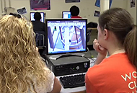
Concept for Populating 1st Village Center
“STEM-Tech Center”
Reformat MESA concept to begin in 10th Grade
Open enrollment based on interest in the STEM program & focus on equity
Continue the STEM program & integrate at least one other Virginia Department of Education Career Cluster

Slide 13
Concept for Populating 1st Village Center
Increase total STEM (MESA) program enrollment to 450 (150 per grade level)
Sophomores and Juniors Attend Alternating Days & Seniors Attend Full-Time (300 students removed from high school capacity daily)
Create and enroll an additional integrated career cluster, such as Transportation, Distribution & Logistics, for example, to add approximately 150 students daily and remove these students from the capacity of the high schools
Offer all or some core classes through virtual, hybrid (asynchronous) platform and staff needed academic teachers to provide instruction, tutoring, and standards-based project advisory

Slide 14
Concept for Populating 1st Village Center
Run the center for extended hours and year-round to make it accessible to all high school students and teachers in the County to reserve and use spaces
All students attending the center for “STEM-Tech” will still be part of their base-school for all extra-curricular programs that the school provides
Run a café during all hours of operation
Utilize ACPS transportation & network
450 Students Scheduled Out of Their High Schools Daily

Slide 15
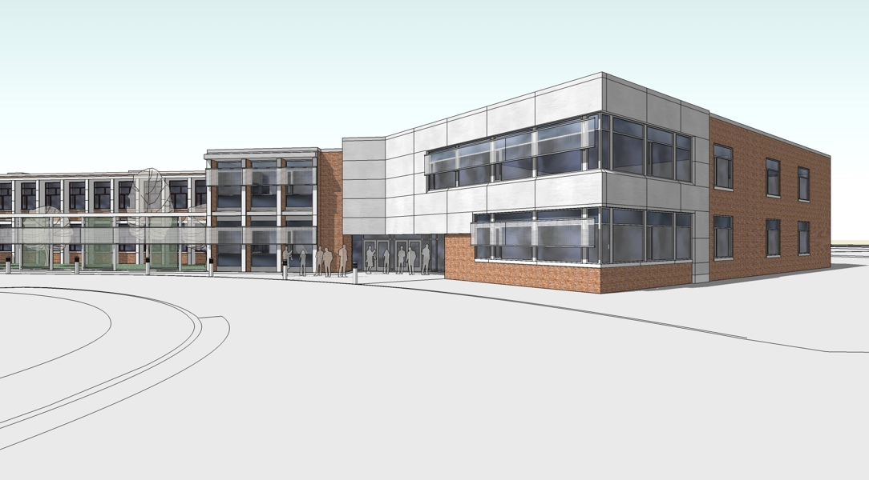
Based at Albemarle High School Scheduled opening fall 2009
Albemarle High School
Scheduled for Fall 2009

Slide 16
Questions?

